Slide 1
Big Mountain Resort Pricing Recommendation

Slide 2
Initial Goal
How can Big Mountain Resort improve profits by more than $770,000 (50% of cost) in this upcoming winter season to offset the costs of a new chair lift? Initial thoughts are to increase ticket prices (assuming 350,000 patrons each purchase 1 ticket this year we would need to increase price by $2.20/ticket) and/or lower expenses by 5-10% by closing underused or unused facilities. In order to make sure we are on track we will be continuing to monitor the situation through financial reports and customer surveys through revenue/profit numbers and customer satisfaction(determined by whether customers would be happy to return).

Slide 3
Recommendation and Key Findings
Going forward we should be increasing ticket prices by at least $0.88 (total of $81.88 assuming 350,000 customers each buying 5 tickets and a new lift cost of $1,540,000) to cover costs of the new lift. However it is likely that we can increase it to $85.48 without losing customers.
Main Features that drive price are:
vertical_drop
Snow Making_ac
total_chairs
fastQuads
Runs
LongestRun_mi
trams
SkiableTerrain_ac

Slide 4
Scenarios to model
Permanently closing down up to 10 of the least used runs. This doesn't impact any other resort statistics.
Increase the vertical drop by adding a run to a point 150 feet lower down but requiring the installation of an additional chair lift to bring skiers back up, without additional snow making coverage
Same as number 2, but adding 2 acres of snow making cover
Increase the longest run by 0.2 mile to boast 3.5 miles length, requiring an additional snow making coverage of 4 acres

Slide 5
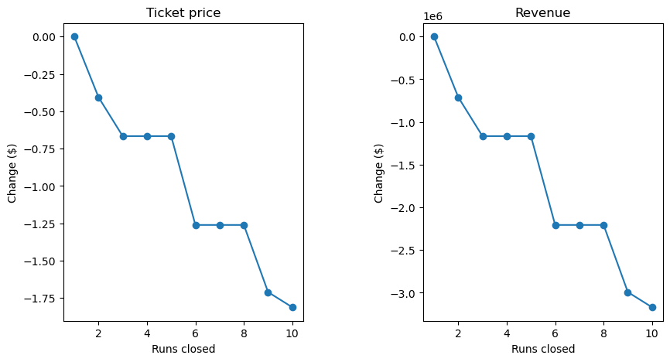
Scenario 1
As shown in the graphs on the left if we want to close some number between 1 and 10 runs we should not be closing 3,4,6 or 7 runs as 3 and 4 runs closing cause the same revenue drop as closing 5 while 6 and 7 runs closing cause the same revenue drop as closing 8 and more runs open means more expenses. This scenario can be further explored by comparing the expenses that would be removed to the loss of revenue.

Slide 6
Scenario 2
Scenario 3
Based on our model this scenario would allow us to increase ticket price by $1.99 which over the season would expect to amount to $3.47 million in revenue. This scenario remains a decent option which would be further explored by finding the exact expense total that would be generated by adding the new run and chair lift.
Based on our model this scenario would create the exact same change in ticket price as Scenario 2 but would increase expenses causing this scenario to be eliminated as a recommendation.

Slide 7
Scenario 4 - Increase longest run by 0.2miles for a total of 3.5miles and additional snow making coverage of 4 acres
Based on our model this scenario would cause no change to the ticket price while increasing expenses thus it is eliminated as a recommendation.

Slide 8
Summary
Big Mountain Resort should be increasing the current ticket price to $85.48 before deciding whether to implement scenario 1, scenario 2, neither or both. After figuring it out we can run the model again to get the new ticket price. Looking forward to the future finance should be trained and able to use this model to predict ticket prices and decide whether to remove or add new facilities to the resort.

